Slide 1
ClimbXpert
Find your holds, easy
Team: Nir Ozery, Alon Strutsovsky, Itai Lahat

Slide 2
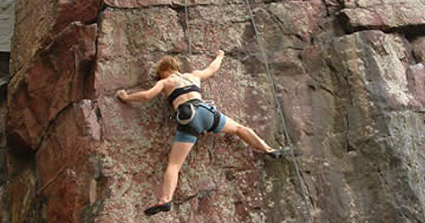
The Climbing World
Climbers are looking for official climbing routes
On site, it is sometimes hard to find the climbing routes and harder to classify their difficulty level

Slide 3
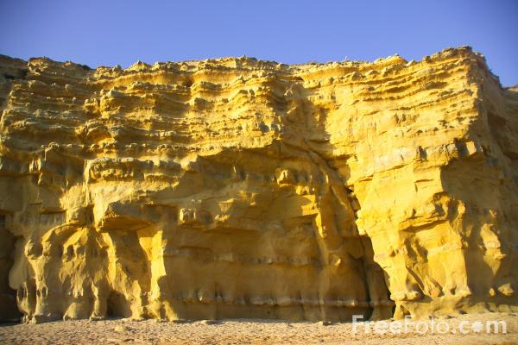
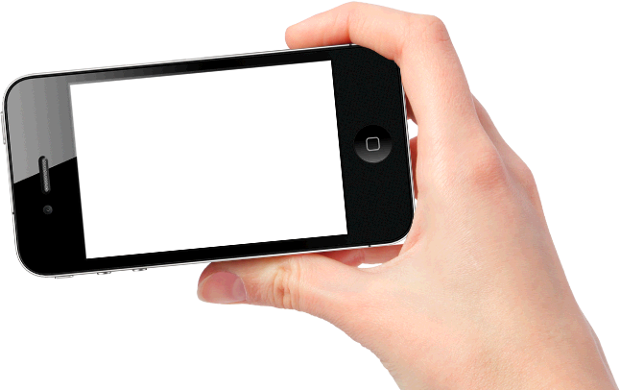
Find Routes on Site
6c
6a
5b

Slide 4
Main Feature
Provide a data base of rock climbing routes
Show the climbing sites on a map
Show the routes and their steps on site using the camera

Slide 5
Additional Features
User added content:
Add routes, modify grades
Add media and comments
Trace your climbing history
Share your experience on social networks (Facebook, Twitter)
Navigation to climbing sites (using an external navigation app like Waze or Google maps)

Slide 6
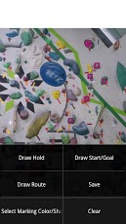
TopoDroid
Take pictures of climbing sites (or use your album)
Create routes by drawing grips out of toolbox.
TopoDroid at Google Play

Slide 7
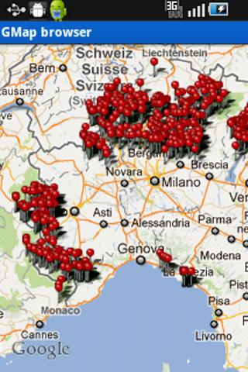
iClimbing
Positions of climbing sites over the map
iClimbing at Google Play
iClimbing at iTunes

Slide 8
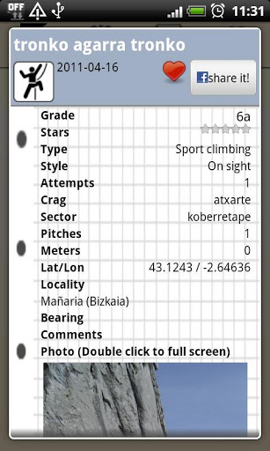
climbDroid
User modifiable DB of climbing sites:
Location
Level
Picture
Required equipment etc…
climbDroid at Google Play

Slide 9

The Crag
Collaborative climbing DB
Locate sites on map
Plan climbing trip
DB of routes over pictures of rocks
Great user experience
The Crag at Google Play

Slide 10
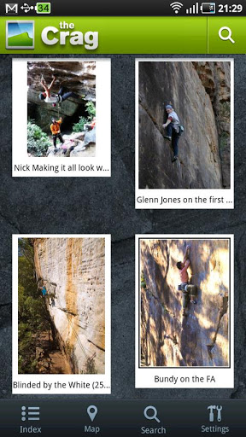
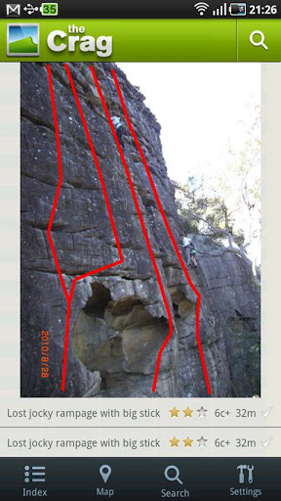
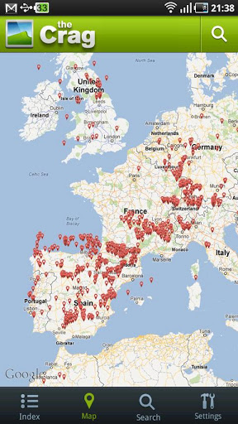
The Crag

Slide 11
The Crag major disadvantage – No AR
When you get to the site you often can’t identify the actual route
You want your smartphone to find it for you
6a
6c
5b

Slide 12
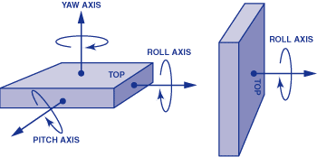
Required Technologies:
AR – Augmented Reality:
“ is a live, direct or indirect, view of a physical, real-world environment whose elements are augmented by computer-generated sensory input such as sound, video, graphics or GPS data.” (taken from Wikipedia http://en.wikipedia.org/wiki/Augmented_reality)
We will use the following sensors to implemented our AR environment:
Camera – Our window to the AR
GPS – Location and height
Compass – Find bearing
Gyro – Angle and orientation of phone (six degrees of freedom accelerometer–gyroscope)

